Slide 1
Getting Started with Scala
Tutorial: IntelliJ IDEA

Slide 2
Download & Install IntelliJ IDEA
https://www.jetbrains.com/idea/download/#section=windows

Slide 3
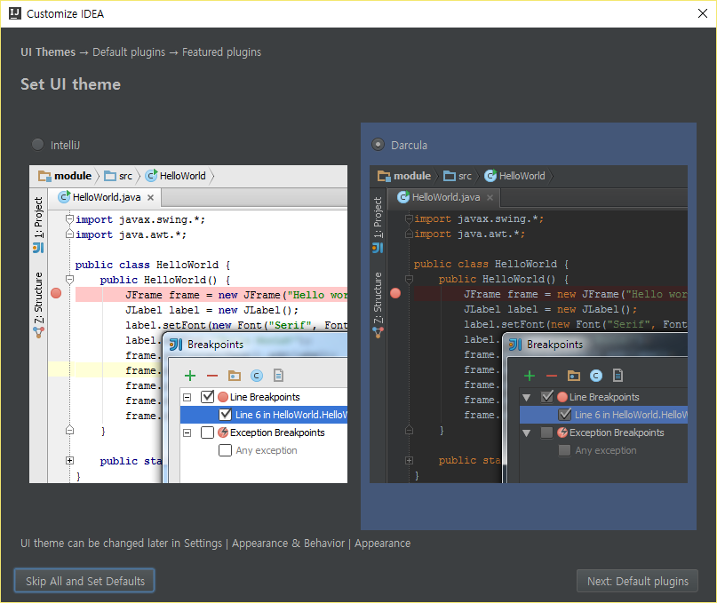
Launch IntelliJ IDEA

Slide 4
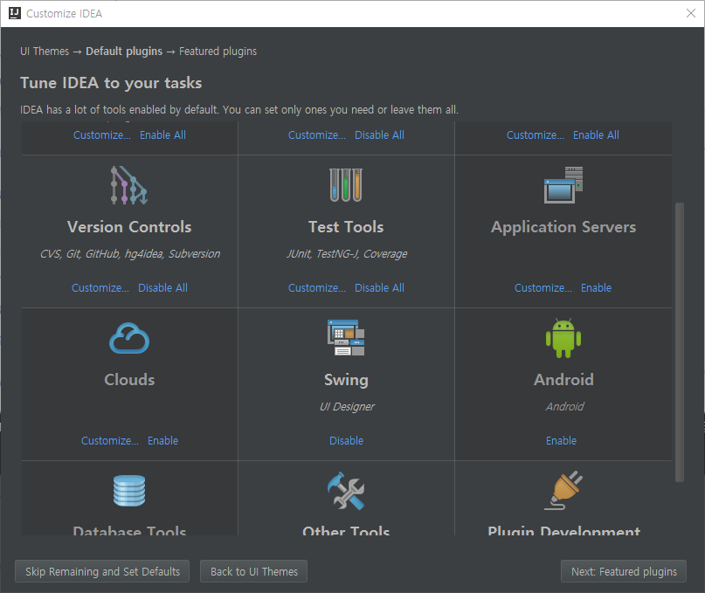
Launch IntelliJ IDEA

Slide 5
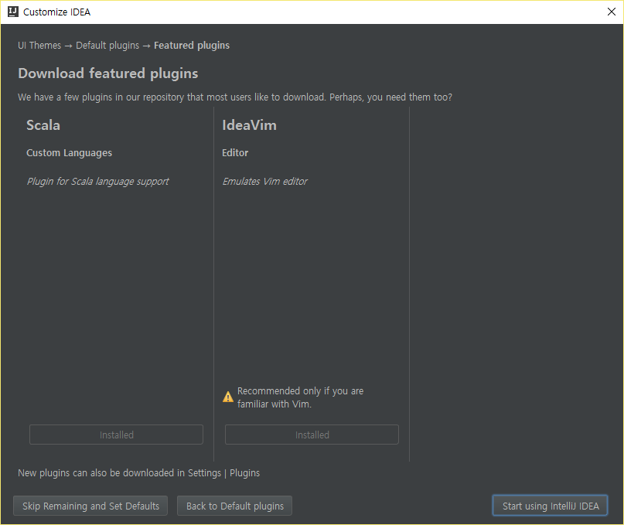
Install Scala (if scala is not installed)

Slide 6
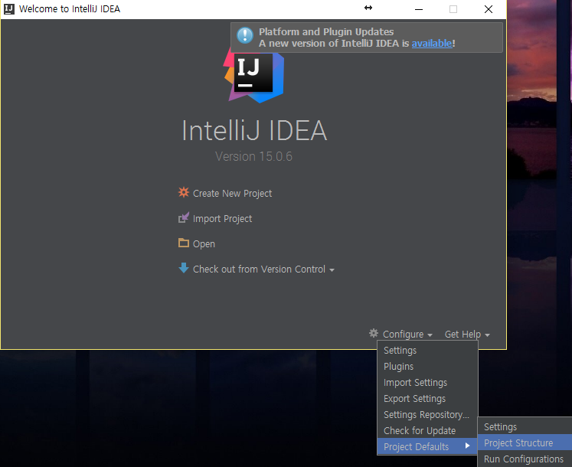
Create New Project – Project Structure

Slide 7
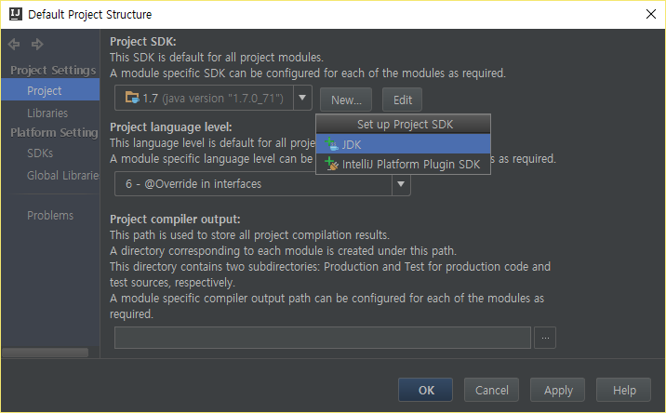
Set up project SDK

Slide 8
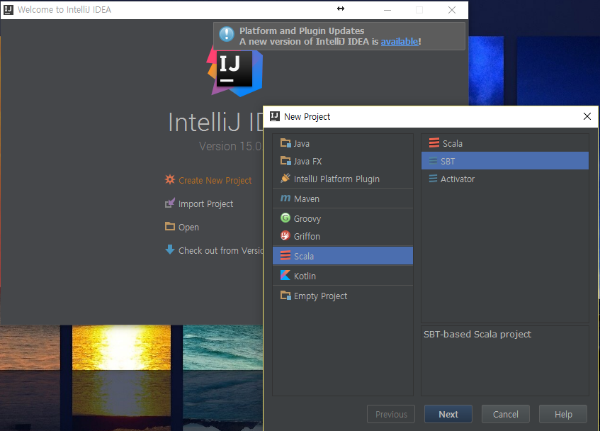
Create New Project – SBT(Scala Build Tool)

Slide 9
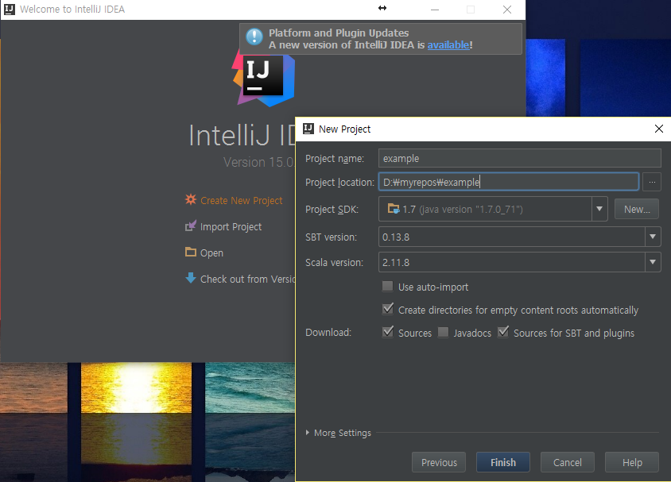
New Project

Slide 10
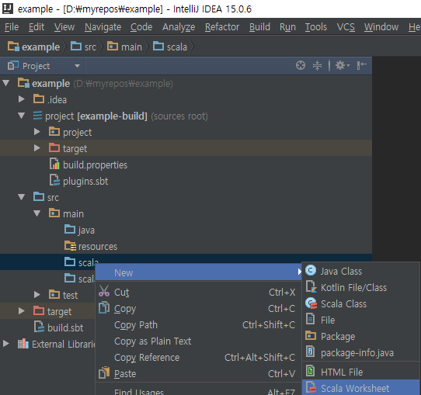
Worksheet test

Slide 11
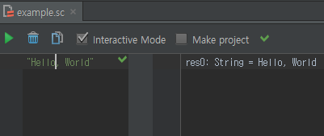
Worksheet test (2)

Slide 12
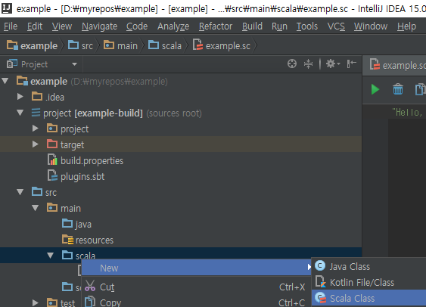
Scala Object Test

Slide 13
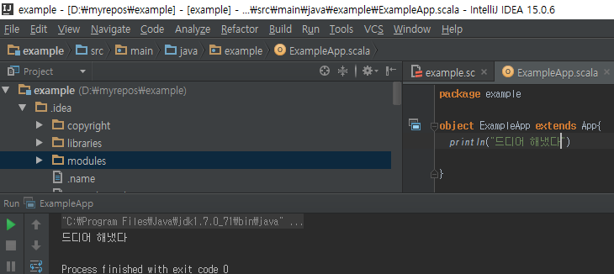
Scala Object Test(2)

Slide 14
Import Project [Optional]
by taking advantage of git & github

Slide 15
Download & Install Git
Git
http://wiki.dataknow.net/tm%2020141121%20Git,%20GitHub
Download & Installation (window)
https://git-scm.com/download/win

Slide 16
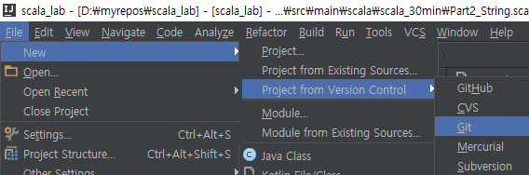
IntelliJ IDEA -> File -> New -> Project from git

Slide 17
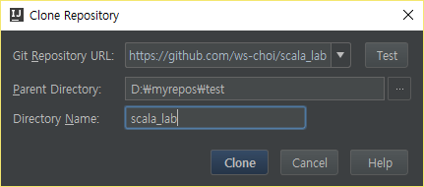
Clone Project
https://github.com/ws-choi/scala_lab

